Slide 1
Week 3
Inheritance and Inclusion Polymorphism
+ Templates

Slide 2
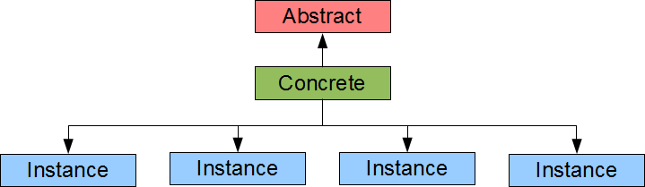
Inheritance Basics
Two types of user-defined types:
Concrete types – definition is known, and are typically child classes when dealing with inheritance.
Abstract Types – definition is not known, typically parent classes that children derive from.

Slide 3

Abstract class with virtual functions.
Pure virtual functions have:
virtual keyword at the beginning
Assignment of 0 (= 0) at the end
No definition in base class
#ifndef SHAPE_H #define SHAPE_H // A Shape // Shape.h class Shape { public: virtual double volume() const = 0; }; #endif
//Typically Abstract classes will have no implementation file(.cpp)

Slide 4
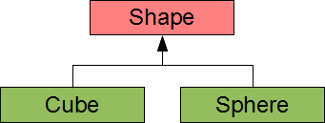
Problems with dynamic typing
The Situation:
We have a base class pointer (Shape *) that is pointing to a child class (Cube)
We want to create a copy of it and store it in another base pointer (Shape *)
The Problem:
Does the compiler know what to sub-class to create if we have more than 1?

Slide 5
Let’s look at some code
https://ict.senecacollege.ca/~oop345/pages/content/inher.html

Slide 6
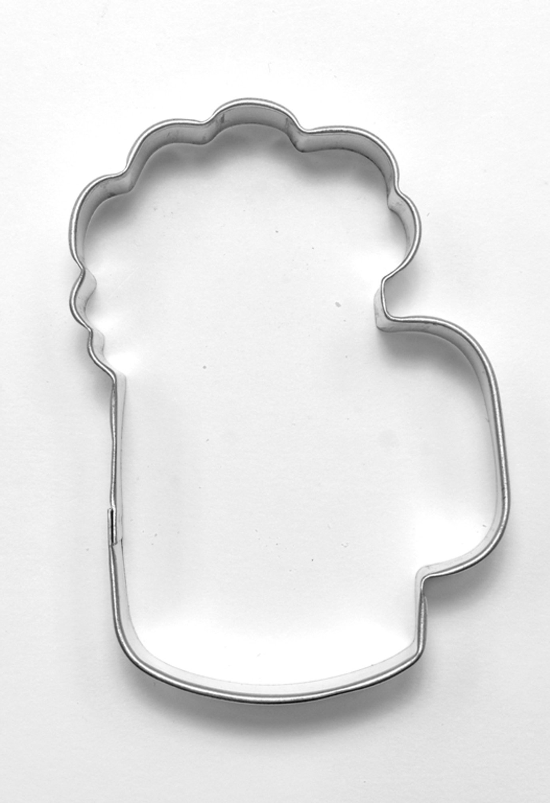
Class Templates
What is it? Templates allow your program to be more flexible by enabling functions and classes to take in different types, while keeping the same name and structure.
Syntax:
template < template-parameter-list > // a function template header return-type function-name( ... ) { //for class use class-key Class-name instead // a function template body // ... }
template <typename T> //Example function with templates void swap(T& a, T& b) { T c; c = a; a = b; b = c; }

Slide 7
Template Parameters
Type Template Parameters
These types allow the program to use type substitutions:
typename
class
Non-type Template Parameters
These types don’t allow the program to uses type substitutions. The are specifically told
Integral or enum type (non-floating point type) Pointer to object or function Lvalue reference | Pointer to a member std::nullptr auto

Slide 8

Template Specialization
Template specialization allows your program to call a specific function that matches the type and name of the function.
Lets look at the code for the example:
https://ict.senecacollege.ca/~oop345/pages/content/templ.html
Specialization takes the syntax of:
template <> //empty parameter list identifies a specialization
Return-type functionName<specializationType>(…){…}

Slide 9
Non-Type Parameters
Non-type parameters specify the type that must be entered when the function is called. It does no substitution.
template <class T, int size>
class Array {
T a[size];
…}
Main.cpp:
Array <int, 50> a, b;

Slide 10
Parameter Defaults
//Array.h
template <class T = int, int size = 50>
class Array {
T a[size];
…}
//Main.cpp:
Array <> a, b;
Array<char, 25> c; //also works

Slide 11
Static data members in Templates
These members last for each member of the class, but for each type of those members.
template <typename T = int, int size = 50> class Array { T a[size]; unsigned n; T dummy; static unsigned count; public: Array() : n{0}, dummy{0} { ++count; } T& operator[](unsigned i) { return i < 50u ? a[i] : dummy; } static unsigned cnt() { return count; } ~Array() { --count; } }; template <typename T = int, int size = 50> unsigned Array<T>::count = 0u; | //In Main.cpp Array<> s, t; Array<double> u; Array<int, 40> v; std::cout << Array<>::cnt() << std::endl; std::cout << Array<double>::cnt() << std::endl; std::cout << Array<int, 40>::cnt() << std::endl; OUTPUT: >2 >1 >1

Slide 12
Variadic Templates
Variadic Templates allow for any arbitrary number of arguments in your parameter list
Syntax looks like:
template<typename… allYourParametersHere> //are belong to us
class etc{…}
Lets look at the code:
https://ict.senecacollege.ca/~oop345/pages/content/templ.html

Slide 13
Joke Time:
A programmer’s husband asks her to go to the store and buy 5 apples. If they have banana’s she should buy 7.
She come returns home with 7 apples.

